Slide 1
Business Office

Slide 2
Where can I find my bill?
All student statements are electronic and should be obtained as follows:
To view bill,
Login to My Buff Portal
Click on Buff Advisor
Click Financial Information
Student Finance
Account Activity
Check accounts regularly and often throughout the semester even when bill is paid.

Slide 3
AUGUST 17, 2021 1st Payment Deadline Requirement
There are only two options for this deadline:
1. Account set up on a payment plan and 25%+ of total charges paid.
2. Account paid in full.
Accounts that are 25%+ partially paid and not set up on a payment plan will receive an account hold until the payment plan is submitted.
Students who do not meet this payment requirement will have their schedule deleted for failure to be in compliance for the payment deadline requirements.

Slide 4
Deferred Payment Plan
September 23, 2021 – 2nd payment deadline, missed payments will be assessed a $20 late fee
October 14, 2021 – 3rd payment deadline, accounts not paid 75%+ will receive an account hold, missed payments will be assessed a $20 late fee
November 03, 2021 – 4th and final payment deadline, accounts not paid in full will receive an account hold, missed payments will be assessed a $20 late fee

Slide 5
Payment Methods
Payment by web-
You can pay by checking or savings account with no additional fee
credit or debit card will include a 2.85% card processing fee
Payment by mail – Check, Money order or Trust Fund Check:
Accounting & Business Office
West Texas A&M University
WT Box 60999
Canyon TX 79016
Must include driver’s license and phone number, student ID, name and specific purpose of payment and must be received in our office prior to the payment deadline.

Slide 6
Sponsored Billing Payments
Submit letter of credit, authorization, or promissory note:
In person 8am-5pm Monday-Friday
By email- using Buff email, sponsorbill@wtamu.edu.
must include Buff ID and full name
Please be sure to contact our Sponsored Billing Coordinator before every semester in which you would like to use sponsored billing
Sponsorships include: *Federal Agencies
*State Agencies
*Company tuition assistance programs
*Some State Pre-Paid tuition programs

Slide 7
Short Term Emergency Tuition and Fee Loans
Last resort when actual payment is delayed:
Application on Buff Advisor
Available 10 to 12 days prior to the 1st payment deadline
90 day loans for Fall and Spring
45 day loans for Summer and Intersession
Maximum of $2,500.00*
Interest begins accruing when the loan is applied to the student’s university balance as a payment at the rate of 5% annually

Slide 8
Book Vouchers
Available to all students with a federal aid and/or scholarship credit balance the Monday, Tuesday or Wednesday of the week before classes begin:
Applied to the student’s Buffalo Gold Card, student must bring card
Available the Monday, Tuesday & Wednesday the week before classes begin
Maximum of $600.00
Form on Business Office Forms webpage, or at cashier window 9am-4pm

Slide 9
Short Term Emergency Book Loans
Last resort when other options are not available:
Application on Buff Advisor
Applied to the student’s Buffalo Gold Card
Available the Monday of the week before classes begin
90 day loans for Fall and Spring
45 day loans for Summer and Intersession
Maximum of $600.00
Interest begins accruing when the loan is applied to the student’s Buffalo Gold card at the rate of 12% annually

Slide 10
Authorized Users
Pay on your student’s behalf
Set up your student’s payment plan
Receive notifications when installments are due
Save payment methods for future use
Schedule payments
Sign up to receive text messages

Slide 12
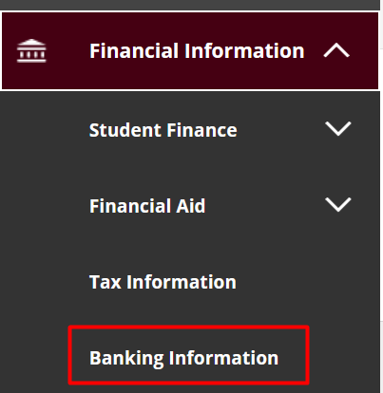
Direct Deposit
Students can sign up to receive any refunds via direct deposit through Buff Advisor

Slide 13
Additional Information
To get additional information regarding Cost of Attendance, Payment Methods and Deadlines, Frequently Asked questions and Refund policies see our web page at http://www.wtamu.edu/administration/business-office.aspx

Slide 14
Contact Us!
Business Office
Phone: 806.651.2080
Email: bo@wtamu.edu
Old Main 104
Facebook: West Texas A&M University Business Office
Twitter: WT Business Office @WTBusinessOffic

